Slide 1
Identification of Triangular Patterns in Brain Networks Using Graph Theory
American International University - Bangladesh
BSc Computer Science
Thesis [Fall 2021]
Mujahid Abdullah Al (15-30013-2)
Pritom Mitchell Rodrigues (17-33394-1)
Md. Al Jubayer (14-27544-3)
Md. Fahad-Uz-Zaman Khan (14-25948-1)
Supervised by
Sajib Hasan
Assistant Professor
Department of Computer Science
American International University-Bangladesh

Slide 2
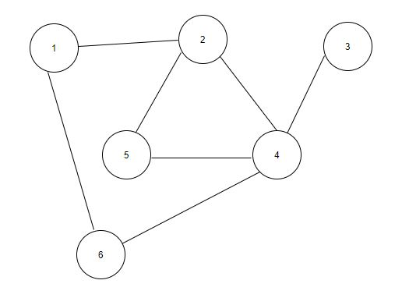
Triangles in Graphs
A triangle in an undirected unweighted graph G (V, E) is a planar subgraph (Also a Bi-Connected Component) containing nodes u, v, w € V such that for any pair of nodes u, v, w there is an edge e € E connecting that pair.
In Figure 1, vertices 2, 5, 4 form a triangle since there is an edge between every pair of these nodes. But there is no other triangle in the graph.
Such triangles indicates a strong connectivity between respective nodes in a graph
Figure 1

Slide 3
Overview of Brain Graphs
Magnetic resonance imaging studies have shown brain regions are connected structurally and functionally.
Static structural brain graphs consist of Region of Interest (ROI) based multiple scale spatial nodes and the edges are defined from the thickness and volume of Gray matter.
Functional connectivity comprises the temporal relations connecting neurophysiological events or statistical dependencies. A discrete cognitive function is associated with each node and the correlation between functions acts as edges.

Slide 4
Triangles in Brain Graphs
Triangles in brain graph can indicate a strong connectivity among certain brain regions in brain networks.
We propose the following hypothesis, “There are Common Triangles in General Brain Networks Which Tends to Occur Fully if Any Pair of Vertices Exists and Are Connected in a Brain Network Rather Than Occurring Partially”
It indicates, if any part of the triangle is present (3 nodes / brain regions of that triangle that are connected) then it will be such a case that all three of them are connected to each other.
This can help identifying strong connectivity and correlation between certain regions of human brain in certain emotional, psychological or physical state.

Slide 5
Triangles in Brain Graphs
For an example, suppose there is a common triangle found among the regions, Primary Visual Cortex, Sixth Visual Area and Primary Motor Cortex, it means when there is any correlation between these three regions , the tend to have a strong connectivity, in other words, there is correlation between each of them.

Slide 6
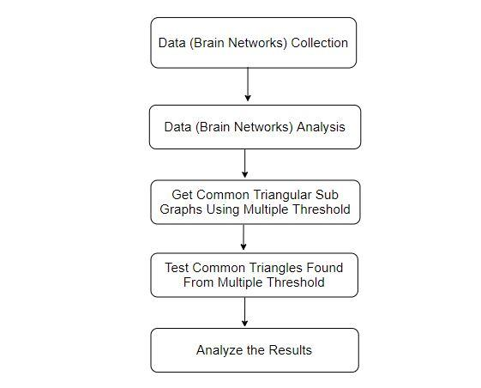
Methodology
Collecting Data
The fMRI data was collected from Human Connectome Project (HCP) 500-subject data release (2014).
The node labelling and region identification was according to the study A Multi-modal Parcellation of Human Cerebral Cortex
The graphs used in this study was proposed by the study Inferring Temporal Information from a Snapshot of a Dynamic Network
400 were built from resting state fMRI data of 100 random subjects.

Slide 7
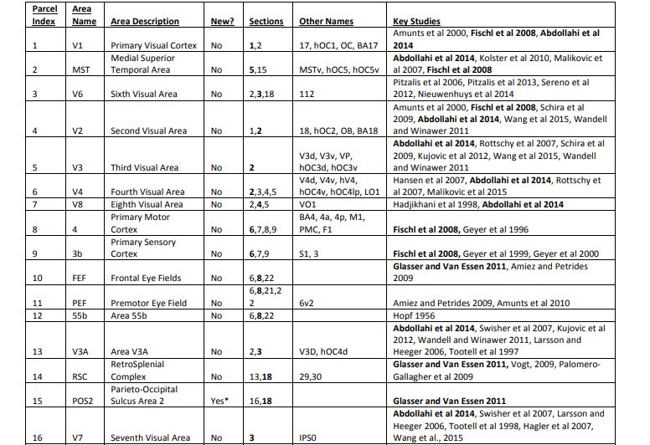
Background

Slide 8
Data Format
1 128
1 2
1 131
1 4
1 5
1 6
1 7
1 137
1 11
1 12
169 180
169 171
170 175
171 180
173 176
173 178
174 175
175 178
176 178
179 180

Slide 9
Intuition
After analyzing the brain graphs we calculated the average shortest path of all the graphs and it was approximately 2.03293
This data indicates that there are a lot of arbitrary paths of length two in the brain networks which tends to establish triangles

Slide 10
Methodology
Triangulation in Sub Graphs Using Multiple Threshold
The first step was generating all possible candidate tuples (all possible subsets of nodes 1 to 180 of size 3) which can form a triangle. There are 180C3 = 955860 subsets with such properties. After that the 400 Graphs were divided into two groups. The first 300 Graphs was in a train set to identify common triangles in them and the remaining 100 Graphs were kept for testing the found common triangles for accuracy.
Five different measures were set to define triangles as common. These were:
Triangles which were present in at least 80 % in test graphs, there were
Triangles which were present in at least 85 % in test graphs
Triangles which were present in at least 90 % in test graphs
Triangles which were present in at least 95 % in test graphs
Triangles which were present in at least 100 % in test graphs

Slide 11
Methodology
Testing Common Triangles Found From Multiple Threshold
For testing purposes, Five different measures were set to define triangles as common. These were:
Triangles which were present in at least 80 % in test graphs, there were
Triangles which were present in at least 85 % in test graphs
Triangles which were present in at least 90 % in test graphs
Triangles which were present in at least 95 % in test graphs
Triangles which were present in at least 100 % in test graphs
Analyzing The Results
Five different measures were set to define triangles as common. For all these five different measures, the test graphs were processed and for each common triangle, it was checked whether it exists partially or fully. If it exists fully, then there will be edges among all pair of three vertices and if it exists partially, then there will be edges in between nodes but they do not form a triangle.

Slide 12
Results
Triangles Present in % of Brain Graphs | Avg. Success in Test Graphs
>= 80% | 96.109919%
>= 85% | 97.309256%
>= 90% | 98.320565%
>= 95% | 99.1560%
100% | 99.9266%

Slide 13
Implementation
The average shortest paths were calculated using Bellman Ford Algorithm for finding all pair shortest paths in each Brain graph. After finding all pair shortest paths from all the graphs, the following formula was used to calculated average shortest path length,
Avg. SPL = ( ∑ l * cnt(l) ) / (T),
where cnt( l ) means number of shortest paths of length l in all the graphs and
T is the total number of paths in all the graphs
300 Brain graphs were separated and common triangles with respect to given certain threshold (% between 80 and 100) were collected by the following approach
Build All possible Triangles
For each triangle count the number of graphs such that it occurs in that graph
Calculate percentage. If it is greater or equal to the given threshold, then include this triangle for test.
Number of occurrence of partially found triangles and fully found triangles were calculated for each triangle among all the test graphs. The success rate = (No. of full occurrence * 100 ) / (No. of total occurrence)

Slide 14
Future Work
Strong connectivity and correlation between certain brain regions can be effective in identifying patterns in brain functions in exploration of emotion, behavior, reflexes and other important aspects of the study of the human brain.
Triangular patterns can be useful recovering damaged or partially corrupt brain images
Brain region activity prediction is a potential possibility according to this hypothesis.

Slide 15
Conclusion
This study intended to find a pattern in correlation between brain region activity analyzing brain networks.
But to establish such a hypothesis with proper statistical reasoning, a large collection of brain graphs will be needed and it should be tested for a long period of time. This study shows the possibility of existence of such a hypothesis in brain networks with a limited amount of data.
We look forward to use these findings to explore the activity and patterns of brain networks to help understand the different aspects of the study of human brain.

